Slide 1

28/10/2022
FINAL YEAR PROJECT
Guided by ~ Prof. Abhijit Banerjee
ACADEMY OF TECHNOLOGY
<number> | P a g e

Slide 2


“AN IOT BASED SMART FLOOD MONITORING SYSTEM”
Submitted by:-
  Sumit Ghosh(16900319038)
  Rup Narayan Sinha(16900319032)
  Bimbit Chakraborty(16900319037)
  Ayan Paul(16900319036)
  Abhijit Sharma(16900319027)
Under the guidance of
Prof. Abhijit Banerjee
ACADEMY OF TECHNOLOGY
Aedconagar, Hooghly-712121
<number> | P a g e

Slide 3

  ACADEMY OF TECHNOLOGY
DEPARTMENT OF ELECTRONICS AND COMMUNICATION ENGINEERING
MAULANA ABUL KALAM AZAD,
P.O. : AEDCONAGAR
HOOGHLY-712121, WESUNIVERSITY
OF TECHNOLOGY
G.T ROAD , ADISAPTAGRAM,WEST BENGAL
.
CERTIFICATE FROM THE SUPERVISOR
This is to certify that the Final Year Project report of B.TECH Fourth Year, entitled “AN IOT BASED SMART FLOOD MONITORING SYSTEM”
have been carried by Sumit Ghosh, Rup Narayan Sinha, Bimbit Chakraborty, Ayan Paul, Abhijit Sharma.
.
The presentation is absolutely based upon their own work under the supervision of Professor Abhijit Banerjee of “Electronics and Communication Engineering Department”.
………………………………………….
(Dr. Abhijit Banerjee) Head of the Department
Department of Electronics and Communication Engineering Academy of Technology
<number> | P a g e

Slide 4

ACKNOWLEDGEMENT
This is a great pleasure for us to express our deep sincere gratitude to our supervisor and Head of The Department, Prof. Abhijit Banerjee, ‘Department of Electronics and Communication Engineering’ of ‘Academy of Technology’ for his valuable guidance and advice. As our final year project supervisor, his patience, dedication, inspiration and enthusiasm helped us a lot during the entire period of our final year project work.
Finally, we would like to express our deepest respect and a social debt of gratitude towards our beloved parents for their support and encouragement. We wish to express a warm thanks to all our family members whose heartiest inspirations provided a strong impetus towards the completion of this work
Thanking all concerned once again.
Sumit Ghosh(Roll No. 16900319038)
Rup Narayan Sinha(Roll No. 16900319032)
Bimbit Chakraborty (Roll No. 16900319037) Ayan Paul(Roll No. 16900319036)
Abhijit Kr Sharma (Roll No.16900319027)
[Seventh Semester, B-Tech, Department of Electronics and Communication Engineering]
<number> | P a g e

Slide 5
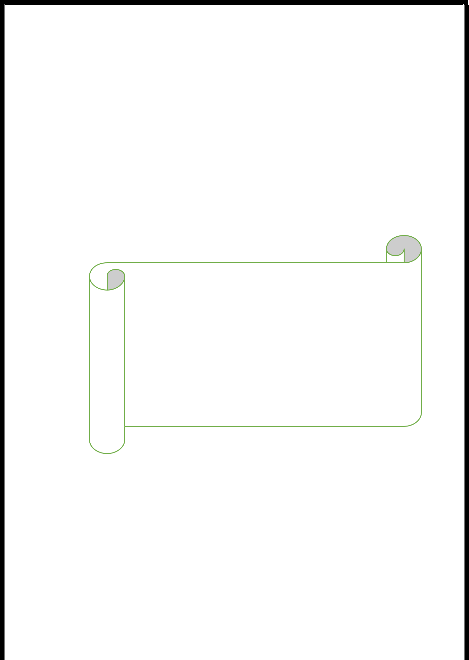
CHAPTER 1: ABSTRACT
<number> | P a g e

Slide 6
1.1 ABSTRACT
In this paper , IoT based Flood Monitoring System which can save many lives from being homeless due to flood in the rivers and canals . Ultrasonic Distance sensor detects the water level in the river or canal. According to the change in ultrasonic waves , there will be a change in the voltages generated which was amplified and used to detect the change in water level. Based on the occupancy a display shows the real time water level of the waterbody.
The system proposed is an advanced solution to ease the prevalent issue of alertness of flood in remote villages. The technology behind this is Internet of Things (IOT), which is an advanced and efficient solution for connecting the things in a network and to connect the entire world of things in a network. Here things might be like electronic gadgets, sensors and automotive electronic component. The system deals with detection of water level in the river of or canals, sending the information to the cloud and receiving the notification in a mobile application. The data updated from the implemented system can be accessible in the internet from anywhere in the world.
<number> | P a g e

Slide 7
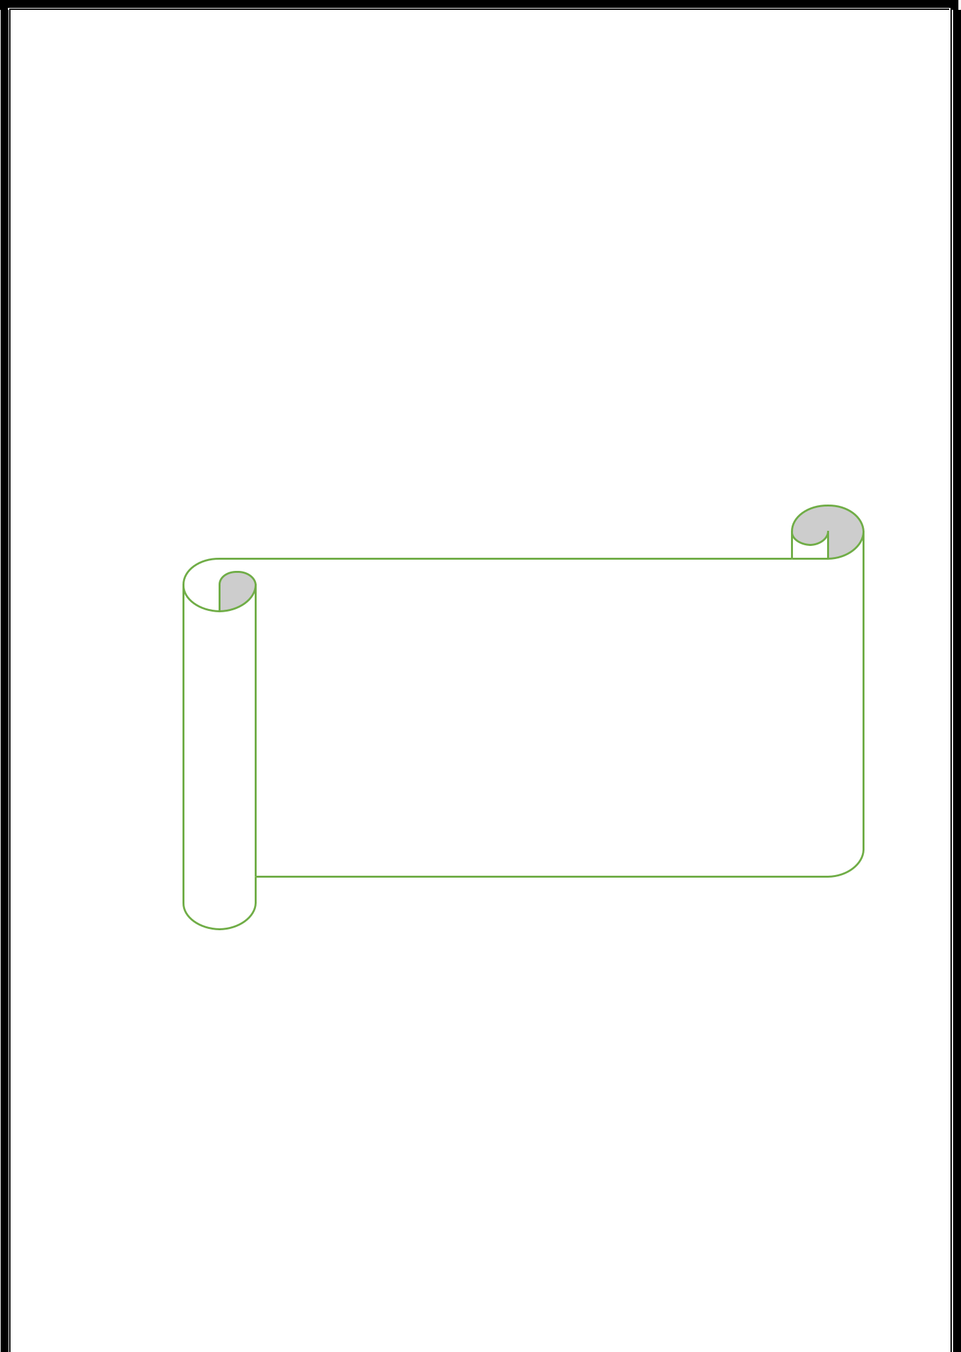
CHAPTER 2: INTRODUCTION
<number> | P a g e

Slide 8
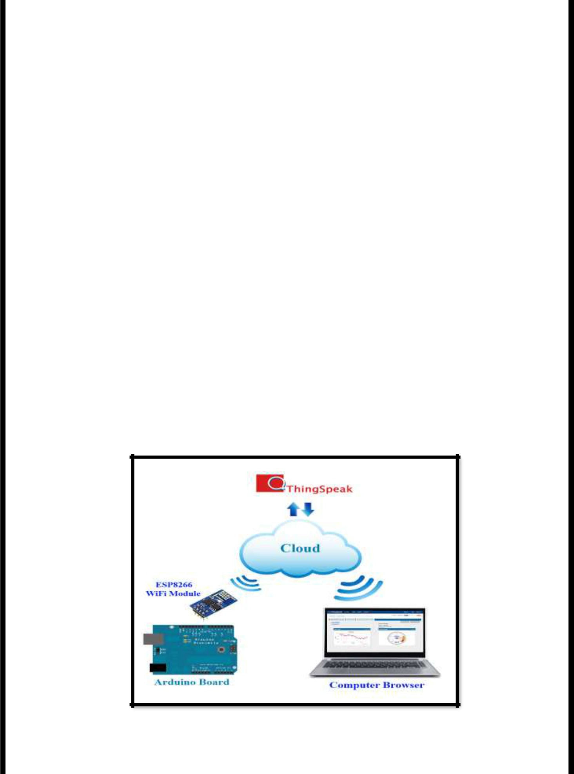

2.1 INTRODUCTION
In both developing and non developing countries flooding is the massive natural disaster that causes loss of human and animal life and property. Flood due to earthquakes in oceans, hurricanes, rainfall and other natural disasters occur in many parts of the globe every year.
During rainfall, unmanaged drainage system in various geographical regions leads to floods and results in lost of many lives. If we proposed some system which uses technology to detect the increase in water level and alert people beforehand then lives can be saved and many people can be evacuated.
Due to logistic and financial situations limitations this solution is more of a proof of concept which measures ground and all extra parameters to arrive on an output. This system than can be scaled up to meet real world conditions.
hgf
Figure 2: Overview of the SMART FLOOD MONITORING SYSTEM
<number> | P a g e

Slide 9
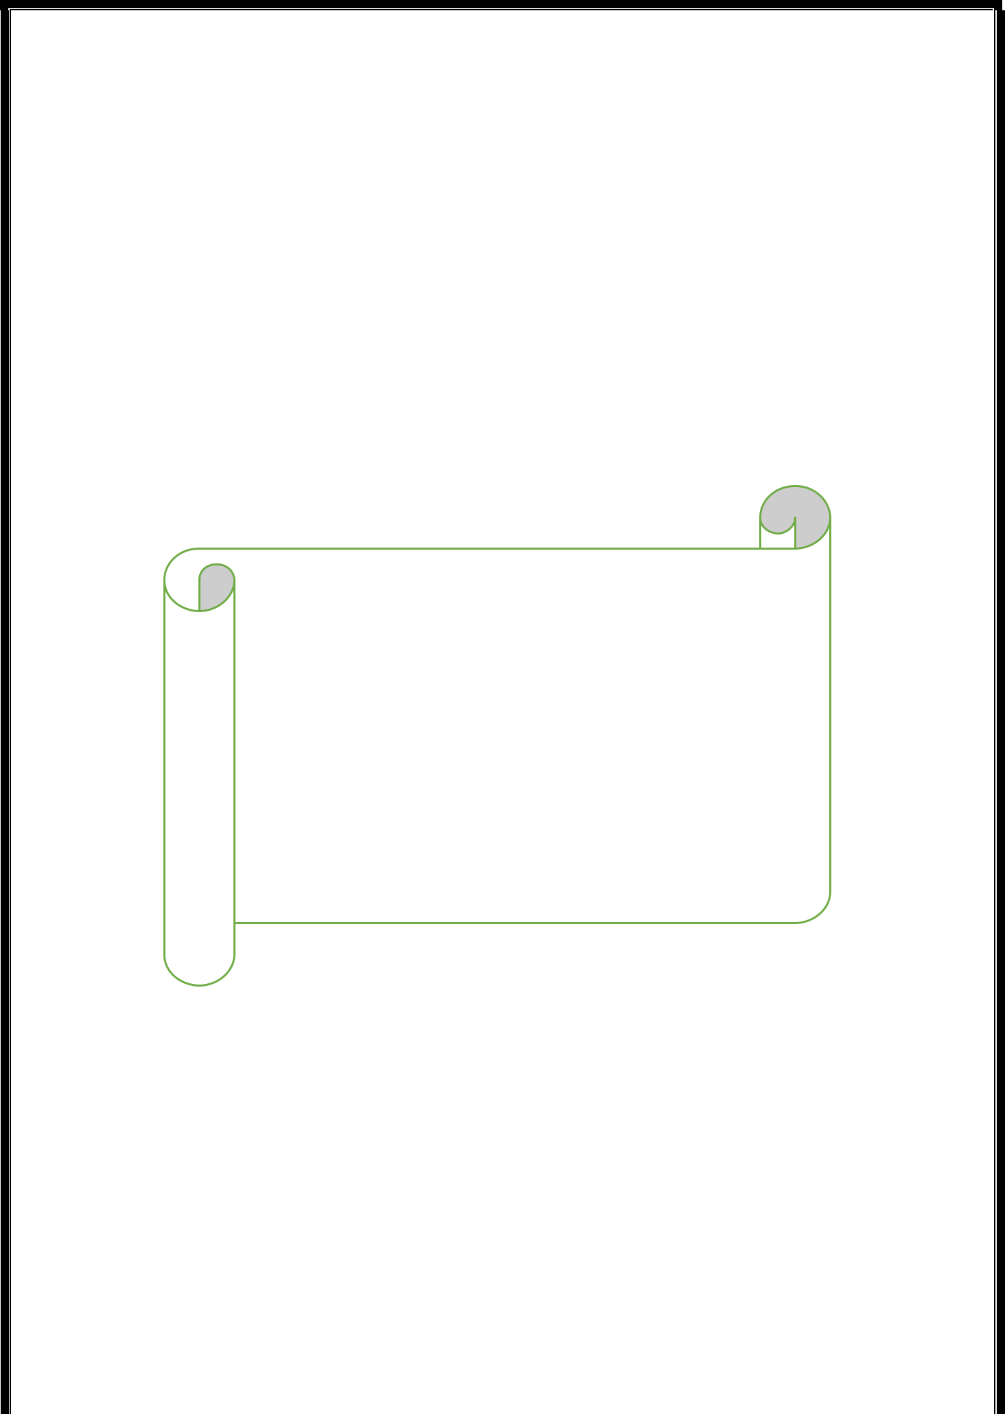
CHAPTER 3: SYSTEM DESIGN
<number> | P a g e

Slide 10
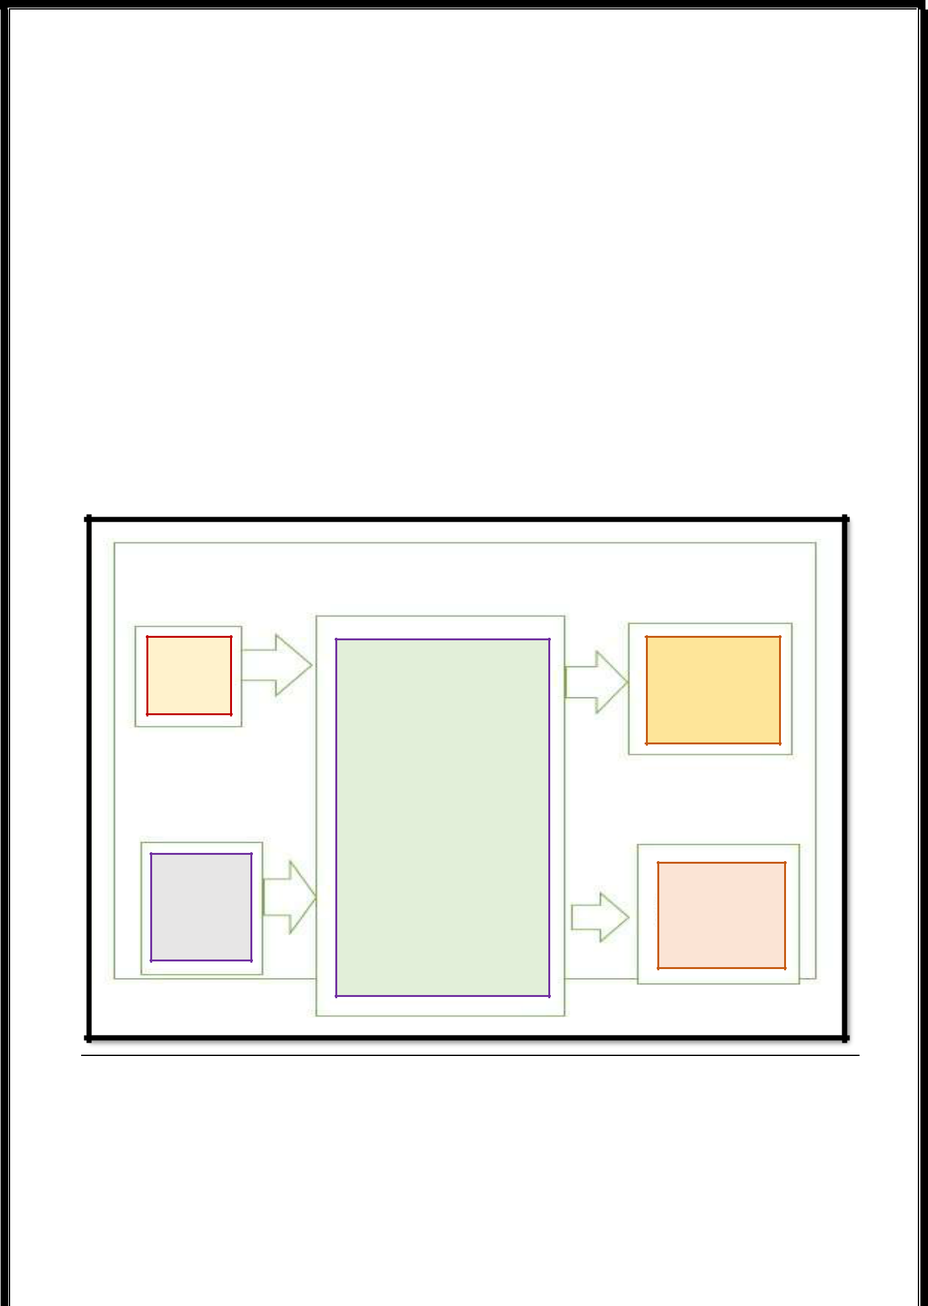
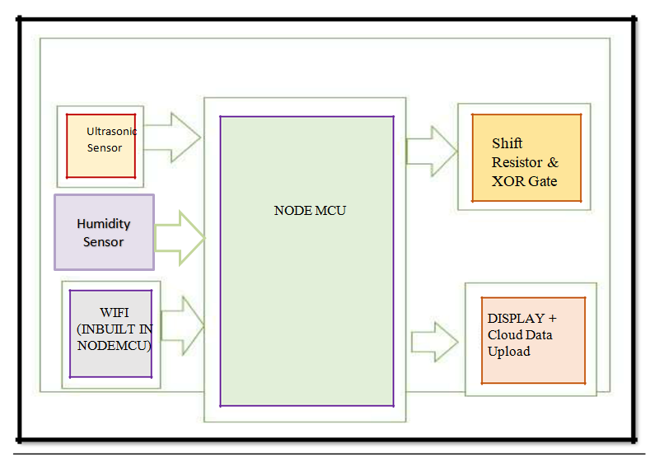
SYSTEM DESIGN
In IOT based smart Flood Monitoring System project, nodeMcu(ESP8266) detects the presence of car using the IR sensor and a LCD display panel. This sensor is directly connected to ESP8266. The nodemcu receives the digital data from the IR sensor. Then it sends the data to the Internet using IOT techniques. The process is repeated by sending the data to the Internet is repeated after constant time intervals. Then the user gets the data after visiting a particular mobile application. The project connects and stores the data on the webserver. Hence the user gets a Live condition of the water level in the river or canal. Internet connection or internet connectivity through the WiFi module is compulsory in this IOT based flood monitoring system.
Ultrasonic
Sensor
Shift Resistor &
XOR Gate
NODE MCU
WIFI (INBUILT IN NODEMCU)
DISPLAY + Cloud Data Upload
Figure 3: System Design Model
<number> | P a g e

Slide 11
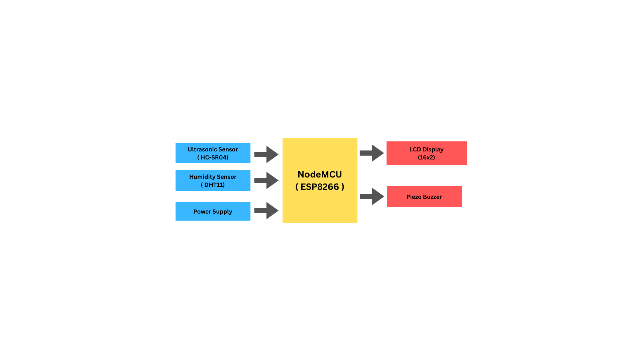





3.3 BLOCK DIAGRAM:-
<number> | P a g e

Slide 12
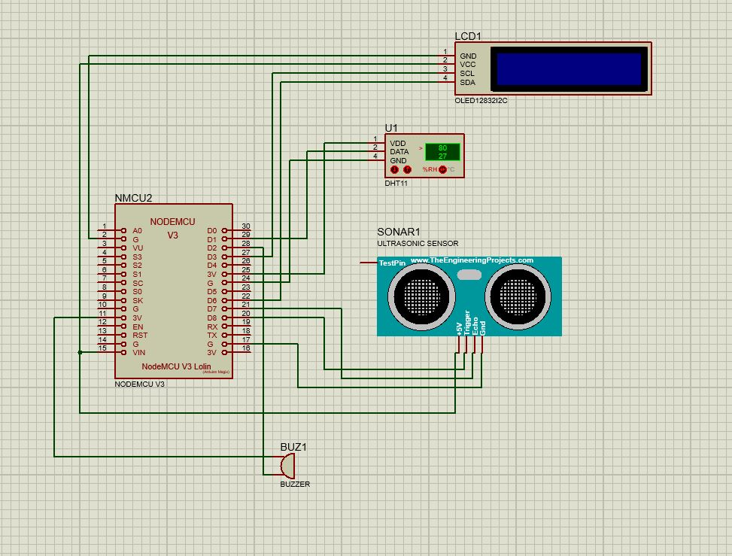
3.4 CIRCUIT DIAGRAM:-
<number> | P a g e

Slide 13
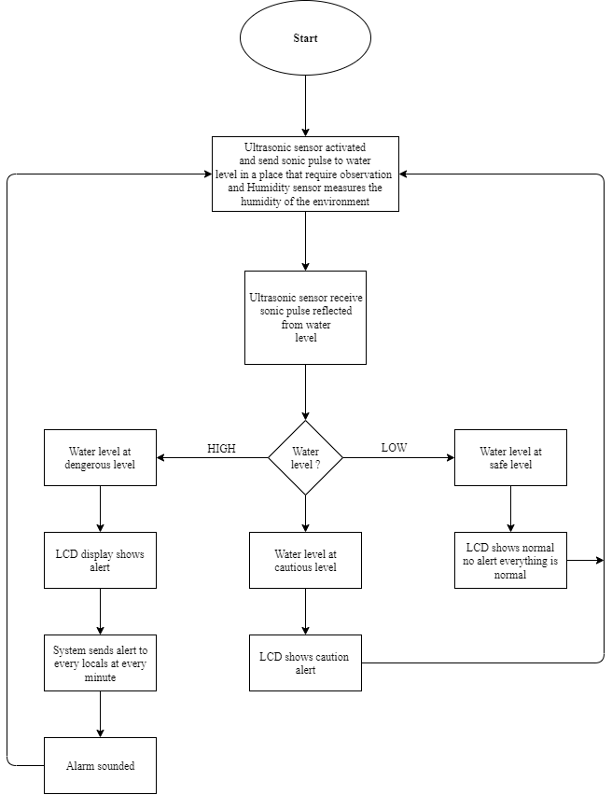
3.5 FLOWCHART:-
<number> | P a g e

Slide 14

4.2 HARDWARE COMPONENTS
4.2.1 NodeMCU:-
It is a microcontroller board developed by Arduino.cc and based on Atmega328. It has 14 digital input/output pins (of which 6 can be used as PWM outputs), 6 analog inputs, a 16 MHz ceramic resonator (CSTCE16M0V53-R0), a USB connection, a power jack, an ICSP header, and a reset button. It contains everything needed to support the microcontroller; simply connect it to a computer with a USB cable or power it with an AC-to-DC adapter or battery to get started.
"Uno" means one in Italian and was chosen to mark the release of Arduino Software (IDE)
1.0. The Uno board and version 1.0 of Arduino Software (IDE) were the reference versions of
Arduino, now evolved to newer releases. The Uno board is the first in a series of USB Arduino boards, and the reference model for the Arduino platform; for an extensive list of current, past, or outdated boards see the Arduino index of boards.
DESCRIPTION:-
Electronic devices are becoming compact, flexible, and cheap that is capable of doing more function. Experts always strive to introduce innovation in automation that requires minimum effort and gives maximum output. The microcontroller was introduced in the electronics industry to make our tasks easy which comes with even a remote connection with automation in any way.
Microcontrollers are widely used in embedded systems and make devices work according to our needs and requirements. NodeMCU is a very valuable addition in electronics that consists of a USB interface, 14 digital I/O pins, 6 analog pins, an Atmega328 microcontroller. It also supports serial communication using Tx and Rx pins.
There are many versions of Arduino boards introduced in the market like NodeMCU, Arduino Due, Arduino Leonardo, Arduino Mega, however, the most common versions are NodeMCU and Arduino Mega.
It is an open-source platform, which means the boards and software are readily available and anyone can modify and optimize the boards for better functionality.
FEATURES:-
NodeMCU is a microcontroller board developed by Arduino.cc which is an open-source electronics platform mainly based on AVR microcontroller Atmega328.
First Arduino project was started in Interaction Design Institute Ivrea in 2003 by David Cuartielles and Massimo Banzi to provide a cheap and flexible way for students and professionals for controlling several devices in the real world.
The current version of NodeMCU comes with a USB interface, 6 analog input pins, 14 I/O digital ports that are used to connect with external electronic circuits. Out of 14 I/O ports, 6 pins can be used for PWM output.
<number> | P a g e

Slide 15
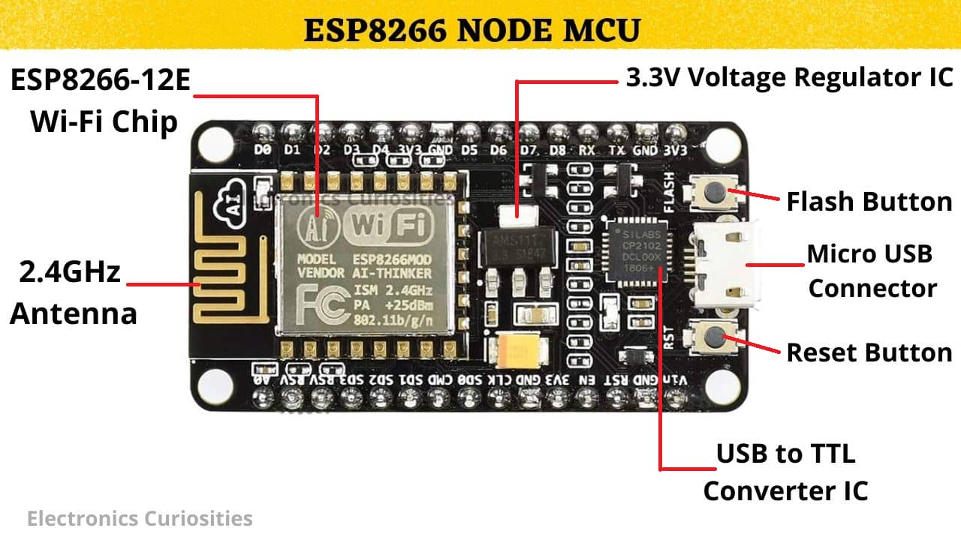
It allows the designers to control and sense the external electronic devices in the real world.
This board comes with all the features required to run the controller and can be directly connected to the computer through a USB cable that is used to transfer the code to the controller using IDE (Integrated Development Environment) software, mainly developed to program Arduino. IDE is equally compatible with Windows, MAC, or Linux Systems, however, Windows is preferable to use. Programming languages like C and C++ are used in IDE.
Apart from USB, a battery or AC to DC adopter can also be used to power the board.
NodeMCU boards are quite similar to other boards in the Arduino family in terms of use and functionality; however, Uno boards don’t come with FTDI USB to Serial driver chip.
There are many versions of Uno boards available; however, Arduino Nano V3 and NodeMCU are the most official versions that come with the Atmega328 8-bit AVR Atmel microcontroller where RAM is 32KB.
When the nature and functionality of the task go complex, a Mirco SD card can be added to the boards to make them store more information.
Figure 4: NodeMCU
<number> | P a g e

Slide 16
NodeMCU comes with a USB interface i.e. USB port is added on the board to develop serial communication with the computer.
Atmega328 microcontroller is placed on the board that comes with several features like timers, counters, interrupts, PWM, CPU, I/O pins and based on a 16MHz clock that helps in producing more frequency and number of instructions per cycle.
It is an open-source platform where anyone can modify and optimize the board based on the number of instructions and tasks they want to achieve.
This board comes with a built-in regulation feature that keeps the voltage under control when the device is connected to the external device.
Reset pin is added in the board that resets the whole board and takes the running program in the initial stage. This pin is useful when the board hangs up in the middle of the running program; pushing this pin will clear everything up in the program and starts the program right from the beginning.
There are 14 I/O digital and 6 analog pins incorporated in the board that allows the external connection with any circuit with the board. These pins provide flexibility and ease of use to the external devices that can be connected through these pins. There is no hard and fast interface required to connect the devices to the board. Simply plug the external device into the pins of the board that are laid out on the board in the form of the header.
The 6 analog pins are marked as A0 to A5 and come with a resolution of 10 bits. These pins measure from 0 to 5V, however, they can be configured to the high range using analogReference() function and AREF pin.
13KB of flash memory is used to store the number of instructions in the form of code.
Only 5 V is required to turn the board on, which can be achieved directly using the USB port or external adopter, however, it can support external power source up to 12 V which can be regulated and limited to 5 V or 3.3 V based on the requirement of the project.
PIN DESCRIPTION:-
There are several I/O digital and analog pins placed on the board which operates at 5V. These pins come with standard operating ratings ranging between 20mA to 40mA. Internal pull-up resistors are used in the board that limits the current exceeding the given operating conditions. However, too much increase in current makes these resistors useless and damages the device.
LED:
NodeMCU comes with a built-in LED which is connected through pin 13. Providing HIGH value to the pin will turn it ON and LOW will turn it OFF.
<number> | P a g e

Slide 17
Vin:
It is the input voltage provided to the Arduino Board. It is different than 5 V supplied through a USB port. This pin is used to supply voltage. If a voltage is provided through a power jack, it can be accessed through this pin.
5V:
This board comes with the ability to provide voltage regulation. 5V pin is used to provide a regulated output voltage. The board is powered up using three ways i.e. USB, Vin pin of the board, or DC power jack.
USB supports voltage around 5V while Vin and Power Jack support a voltage ranges between 7V to 20V. It is recommended to operate the board on 5V. It is important to note that, if a voltage is supplied through 5V or 3.3V pins, they result in bypassing the voltage regulator that can damage the board if the voltage surpasses its limit.
GND:
These are ground pins. More than one ground pin is provided on the board which can be used as per requirement.
Reset:
This pin is incorporated on the board which resets the program running on the board. Instead of physical reset on the board, IDE comes with a feature of resetting the board through programming.
IOREF:
This pin is very useful for providing voltage reference to the board. A shield is used to read the voltage across these pins which then select the proper power source.
PWM:
PWM is provided by 3, 5, 6, 9, 10, 11pins. These pins are configured to provide 8-bit output PWM.
SPI:
It is known as Serial Peripheral Interface. Four pins 10(SS), 11(MOSI), 12(MISO), 13(SCK) provide SPI communication with the help of the SPI library.
AREF:
It is called Analog Reference. This pin is used for providing a reference voltage to the analog inputs.
TWI:
It is called Two-wire Interface. TWI communication is accessed through Wire Library. A4 and A5 pins are used for this purpose.
Serial Communication:
Serial communication is carried out through two pins called Pin 0 (Rx) and Pin 1 (Tx). Rx pin is used to receive data while Tx pin is used to transmit data.
<number> | P a g e

Slide 18
External Interrupts:
Pin 2 and 3 are used for providing external interrupts. An interrupt is called by providing a LOW or changing value.
APPLICATIONS:-
NodeMCU comes with a wide range of applications. A larger number of people are using Arduino boards for developing sensors and instruments that are used in scientific research. Following are some main applications of the board.
Security and Defense System
Embedded system
Digital Electronics and Robotics
Parking Lot Counter
Weighing Machines
Traffic Light Count Down Timer
Medical Instrument
Emergency Light for Railways
Home Automation
Industrial Automation
4.2.2 ESP8266 Wi-fi Module:-
The NodeMCU Wi-fi is an NodeMCU with an integrated Wi-fi module. The board is based on the ATmega328P integrated with an ESP8266 Wi-fi Module. The ESP8266 Wifi Module is a self- contained SoC with an integrated TCP/IP protocol stack that can give access to your Wifi network (or the device can act as an access point). One useful feature of Uno Wi-fi is to support OTA (over-the-air) programming, either for the transfer of Arduino sketches or Wi-fi firmware. The ESP8266 Wifi Module is a self-contained SOC with an integrated TCP/IP protocol stack that can give any microcontroller access to your Wi-fi network. The ESP8266 is capable of either hosting an application or offloading all Wi-fi networking functions from another application processor. Each ESP8266 module comes pre-programmed with an AT command set firmware, meaning, you can simply hook this up to your Arduino device and get about as much Wi-fi ability as a Wi-fi Shield offers (and that's just out of the box)! The ESP8266 module is an extremely cost-effective board with a huge and ever-growing community.
This module has a powerful enough on-board processing and storage capability that allows it to be integrated with the sensors and other application-specific devices through its GPIOs with minimal development up-front and minimal loading during runtime. Its high degree of on-chip integration allows for minimal external circuitry, including the front-end module, which is designed to occupy a minimal PCB area. The ESP8266 supports APSD for VoIP applications
<number> | P a g e

Slide 19
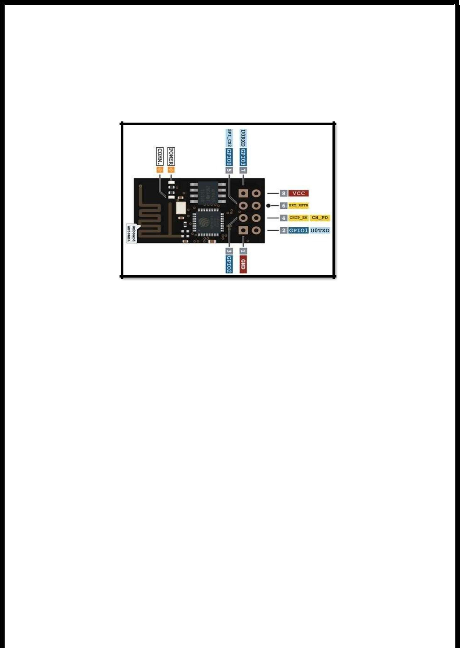
and Bluetooth co-existence interfaces, it contains a self-calibrated RF allowing it to work under all operating conditions and requires no external RF parts.
There is an almost limitless fountain of information available for the ESP8266, all of which has been provided by amazing community support. In the Documents section below you will find many resources to aid you in using the ESP8266, even instructions on how to transform this module into an IoT (Internet of Things) solution.
Figure 5:ESP8266 Wi-Fi Module
FEATURES:-
• 802.11 b/g/n
Wi-Fi Direct (P2P), soft-AP
Integrated TCP/IP protocol stack
Integrated TR switch, balun, LNA, power amplifier and matching network
Integrated PLLs, regulators, DCXO and power management units
• +19.5dBm output power in 802.11b mode
Power down leakage current of <10uA
1MB Flash Memory
Integrated low power 32-bit CPU could be used as application processor
SDIO 1.1 / 2.0, SPI, UART
STBC, 1×1 MIMO, 2×1 MIMO
A-MPDU & A-MSDU aggregation & 0.4ms guard interval
Wake up and transmit packets in < 2ms
• Standby power consumption of < 1.0mW (DTIM3)
<number> | P a g e

Slide 20
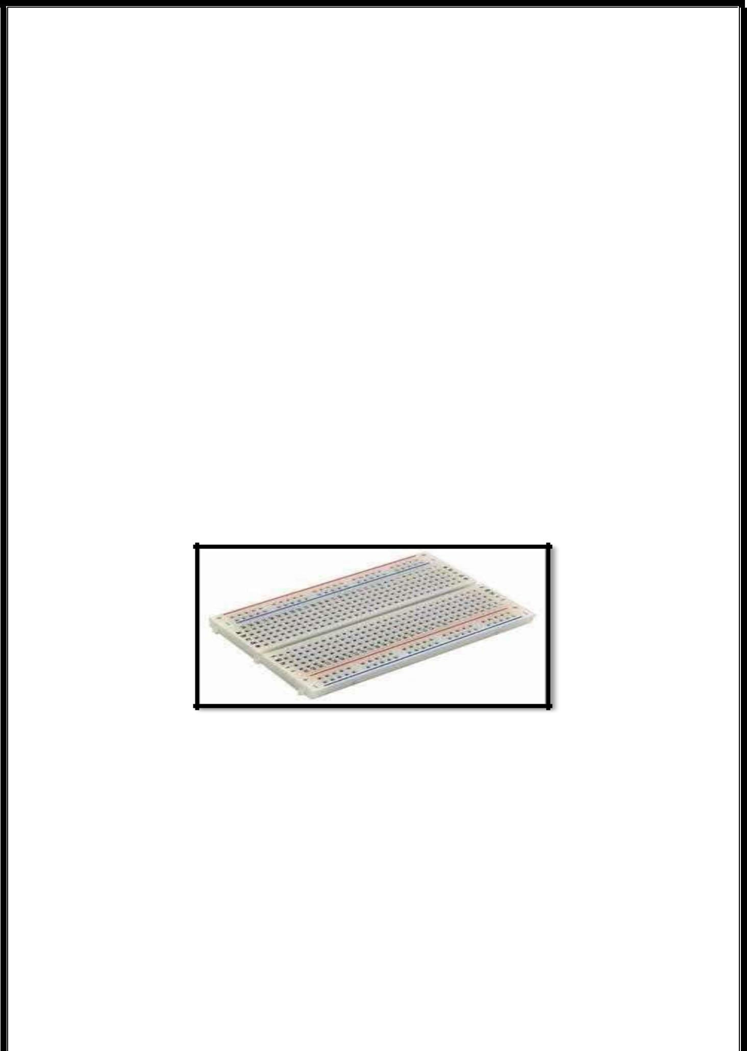
APPLICATIONS:-
Smart Power Plug
Home Automation
Mesh network
Industrial wireless control
Baby Monitor
Network Camera
Sensor networks
Wearable electronics
4.2.3 Bread Board:-
A breadboard is a device for a temporary prototype with electronics and test circuit designs. Most electronic components in electronic circuits can be interconnected by inserting their leads or terminals into the holes and then making connections through wires where appropriate.
Figure 6:Bread Board
4.2.3 Jumpers:-
In electronics and particularly computing, a jumper is a short length of conductor used to close, open or bypass part of an electronic circuit. They are typically used to set up or configure printed circuit boards, such as the motherboards of computers. The process of setting a jumper is often called strapping.
DESIGN:-
Jumper pins (points to be connected by the jumper) are arranged in groups called jumper blocks, each group having at least one pair of contact points. An appropriately sized conductive sleeve called a jumper, or more technically, a shunt jumper is slipped over the
pins to complete the circuit.

Slide 21
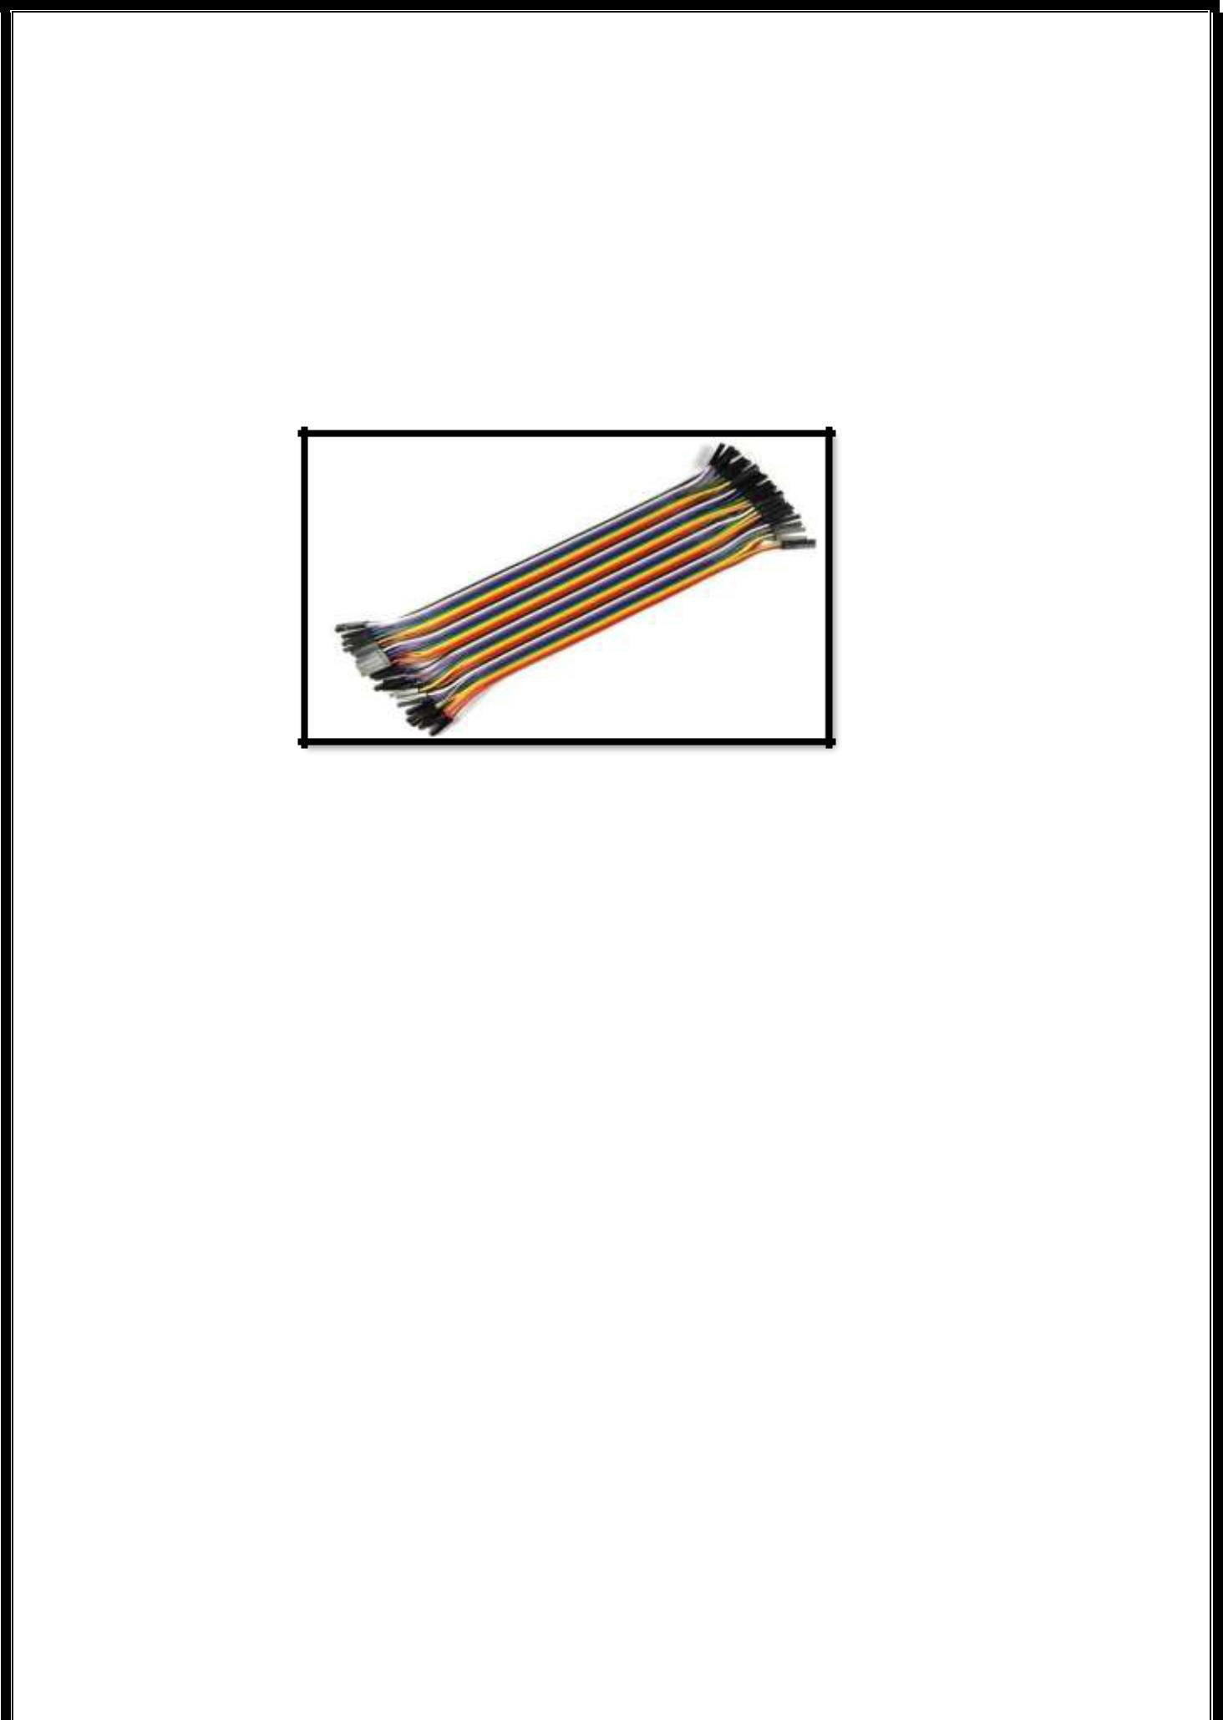
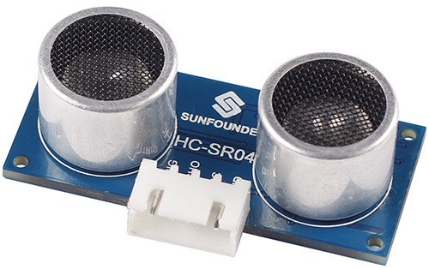
Jumpers must be electrically conducting; they are usually encased in a non-conductive block of plastic for convenience. This also avoids the risk that an unshielded jumper will accidentally short out something critical (particularly if it is dropped on a live circuit).
USE:-
When a jumper is placed over two or more jumper pins, an electrical connection is made between them, and the equipment is thus instructed to activate certain settings accordingly. For example, with older PC systems, CPU speed and voltage settings were often made by setting jumpers.
Figure 7: Jumpers
4.2.5 Ultra Sonic Sensor:-
Ultrasonic ranging module HC - SR04 provides 2cm - 700cm non-contact measurement function, the ranging accuracy can reach to 3mm.Ensured stable signal within 5m, gradually faded signal outside 5m till disappearing at 7m position.
The modules includes ultrasonic transmitters, receiver and control circuit. The basic principle of work:
(1) Using IO trigger for at least 10us high level signal；
(2) The Module automatically sends eight 40 kHz and detect whether there is a pulse signal back.
(3) IF the signal back, through high level , time of high output IO duration is the time from sending ultrasonic to returning. Test distance = (high level time×velocity of sound (340M/S) / 2.
Pin Function
TRIG: Trigger Pulse Input
ECHO: Echo Pulse Output
GND: Ground
VCC: 5V Supply
Figure 8:- HC-SR04
<number> | P a g e

Slide 22
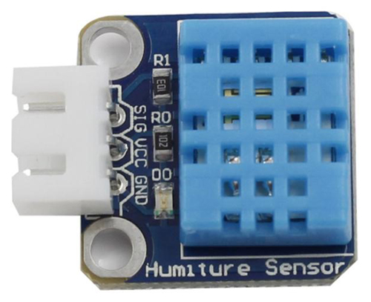
4.2.6 Humidity Sensor :-
The digital temperature and humidity sensor DHT11 is a composite sensor that contains a calibrated digital signal output of temperature and humidity. The technology of a dedicated digital modules collection and the temperature and humidity sensing technology are applied to ensure that the product has high reliability and excellent long-term stability.
The sensor includes a resistive sense of wet component and an NTC temperature measurement device, and is connected with a high-performance 8-bit microcontroller.
Features
1) A humiture sensor module to test temperature and humidity, which uses the sensor DHT11.
2) Humidity measurement range: 20 - 90%RH
3) Temperature measurement range: 0 - 60℃
4) Output digital signals indicating temperature and humidity
5) Working voltage:DC 5V; PCB size: 2.0 x 2.0 cm
6) Humidity measurement accuracy: ±5%RH
7) Temperature measurement accuracy: ±2℃.
Figure 9:- DHT11(Humidity Sensor)
<number> | P a g e

Slide 23
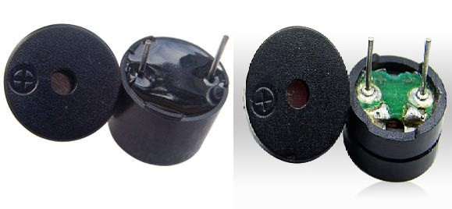
4.2.7 Piezo Buzzer :-
As a type of electronic buzzer with integrated structure, buzzers, which are supplied by DC power, are widely used in computers, printers, photocopiers, alarms, electronic toys, automotive electronic devices, telephones, timers and other electronic products for voice devices. Buzzers can be categorized as active and passive ones (see the following picture). Turn the pins of two buzzers face up, and the one with a green circuit board is a passive buzzer, while the other enclosed with a black tape is an active one. The difference between an active buzzer and a passive buzzer is:
An active buzzer has a built-in oscillating source, so it will make sounds when electrified. But a passive buzzer does not have such source, so it will not tweet if DC signals are used; instead, you need to use square waves whose frequency is between 2K and 5K to drive it. The active buzzer is often more expensive than the passive one because of multiple built-in oscillating circuits.
Features:
1)Use an S8550 PNP transistor for drive
2)Convenient control by program
3)Working voltage: 3.3 - 5V; PCB size: 2.0 x 2.0 cm
4)With power light and indicator of digital signal output
Piezo Buzzer
<number> | P a g e

Slide 24
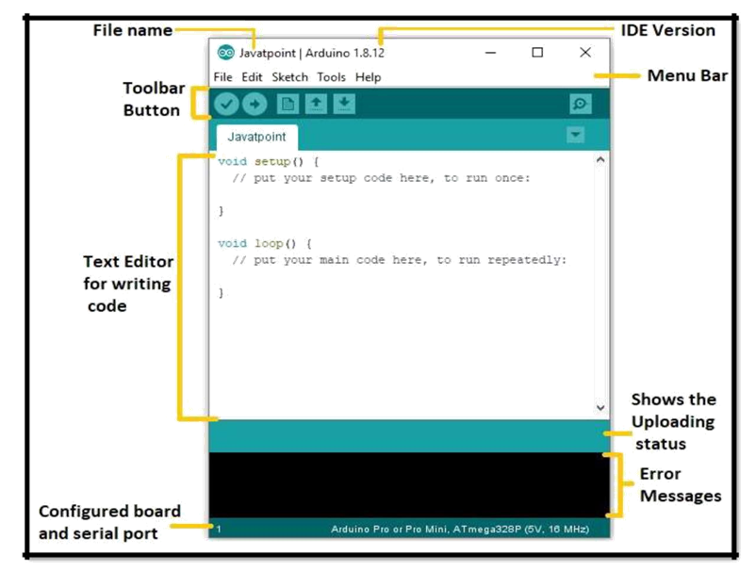
4.3 SOFTWARE COMPONENTS
4.3.1. Arduino IDE:-
Arduino consists of both a physical programmable circuit board (often referred to as a microcontroller) and a piece of software, or IDE (Integrated Development Environment) that runs on your computer, used to write and upload computer code to the physical board. Arduino is an open-source computer hardware and software company, project, and user community that designs and manufactures single-board microcontrollers and microcontroller kits for building digital devices and interactive objects that can sense and control objects in the physical world. The project's products are distributed as open-source hardware and software, which are licensed under the GNU Lesser General Public License (LGPL) or the GNU General Public License (GPL) permitting the manufacture of Arduino boards and software distribution by anyone. Arduino boards are available commercially in preassembled form, or as do-it-yourself (DIY) kits.
Figure 10: Arduino IDE
Figure 10: Arduino IDE
<number> | P a g e

Slide 25
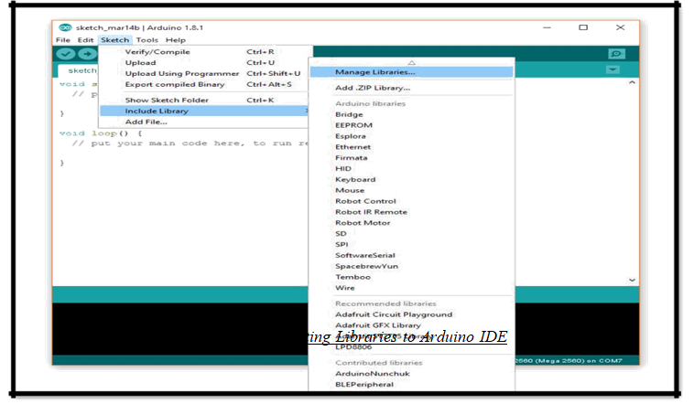
The Arduino environment can be extended through the use of libraries, just like most programming platforms. Libraries provide extra functionality for use in sketches, e.g. working with hardware or manipulating data. To use a library in a sketch, select it from Sketch > Import Library.
Several libraries come installed with the IDE, but you can also download or create your own.
See these instructions for details on installing libraries.
Libraries are files writte n in C or C++ (.c, .cpp) that provide your sketches with extra functionality (e.g. the ability to control an LED matrix, or read an encoder, etc.). They were introduced in Arduino 0004.
To use an existing library in a sketch simply go to the Sketch menu, choose "Import Library", and pick from the libraries available. This will insert an #include statement at the top of the sketch for each header (.h) file in the library's folder. These statements make the public functions and constants defined by the library available to your sketch. They also signal the Arduino environment to link that library's code with your sketch when it is compiled or uploaded.
User-created libraries as of version 0017 go in a subdirectory of your default sketch directory. For example, on OSX, the new directory would be ~/Documents/Arduino/libraries/. On Windows, it would be My Documents\Arduino\libraries\. To add your library, create a new directory in the libraries directory with the name of your library. The folder should contain a C or C++ file with your code and a header file with your function and variable declarations. It will then appear in the Sketch | Import Library menu in the Arduino IDE.
4.3.1.1 Libraries:-
<number> | P a g e

Slide 26
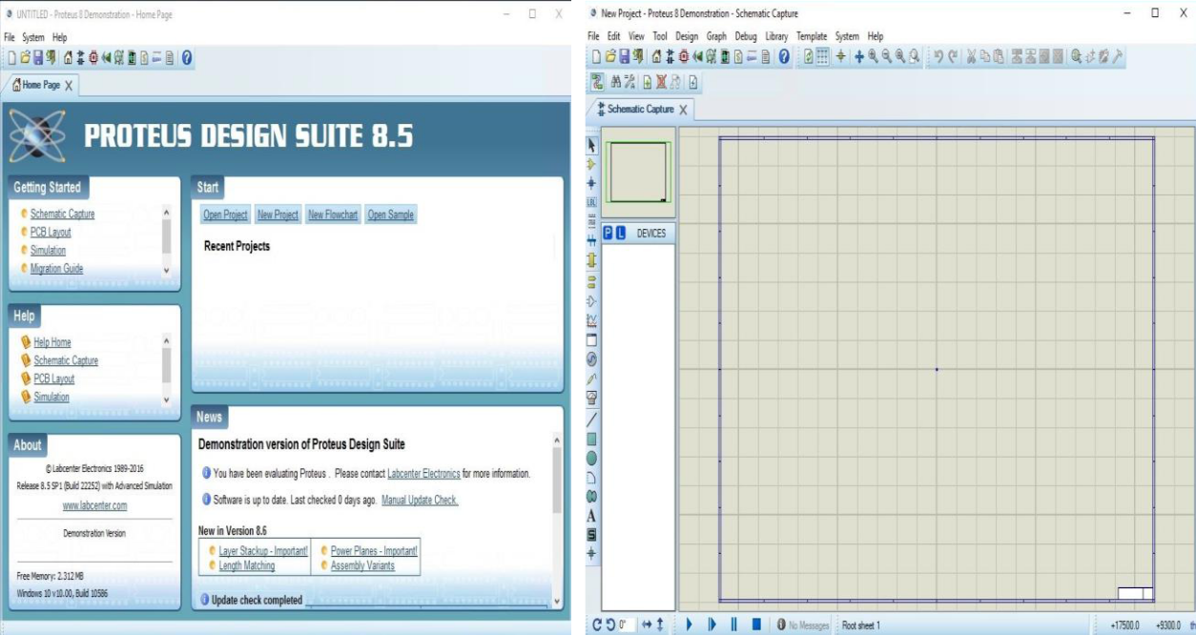
4.3.3 Proteus Platform:-
The Proteus Design Suite is a proprietary software tool suite used primarily for electronics design automation. The software is used mainly by electronic design engineer and technicians to create schemetics and electronic prints for manufacturing
1- Simple : circuit designing is very easy and relaible.
2- Open Source : Free, no license needed to use.
3- Simulator : It offers a good interface for designing and simulates our project.
4- Advantage : Its advantages are intelligent layout, accurate analysis, single-chip software debugging, single-chip and peripheral circuit co- simulation, PCB automatic layout and wiring.
5- Disadvantage: It is difficult to debug software without system hardware. 3. It is very costly and time-consuming to remake the board.
6- Hard to install: Whenever new component need a library file need to download and extract into software library location. Then add it and then use it. Too many steps
Figure 19: Proteus Platform
<number> | P a g e

Slide 27

APPLCATIONS ADVANTAGES ,
DISADVANTAGES ,
& COST ESTIMATION
<number> | P a g e

Slide 28
6.1 APPLICATIONS:-
1 . Able to independently monitor water level on remote site.
2 .Send data of water level status from all sites to a centralized server.
3. Have a web-based system accessible 24×7 by user via internet connection.
4. Have a trending feature showing live or historical data.
5. Have a split screen comparing the water movement from four different sites simultaneously.
6. Overall area map showing live status of each station being monitored.
6.2 COST ESTIMATION :-
.
SERIAL NO. | HARDWARE COMPONENT | PRICE (in Rs)
1 | Nodemcu with USB cable | 300
2 | Ultrasonic Sensor | 100
3 | Lcd 16x2 | 150
4 | Breadboard | 50
5 | Jumpers wires | 80
6 | Humidity sensor DHT 11 | 130
7 | LED | 20
Total cost estimated = Rs. 830.
If order placed in bulk then cost will be reduced
<number> | P a g e

Slide 29
6.2 ADVANTAGES & DISADVANTAGES:-
6.2.1 ADVANTAGES:-
1. Low cost IR sensor
2. Easy to interface
3. Easy installation and operability
4. Can be Monitored remotely
5. Low power consumption
6.2.2 DISADVANTAGES:-
1. Low distance range
2. Not functional in areas having no or poor internet connection
3. Heavily depends on power supply
4. Insensitive IR sensor
<number> | P a g e

Slide 30
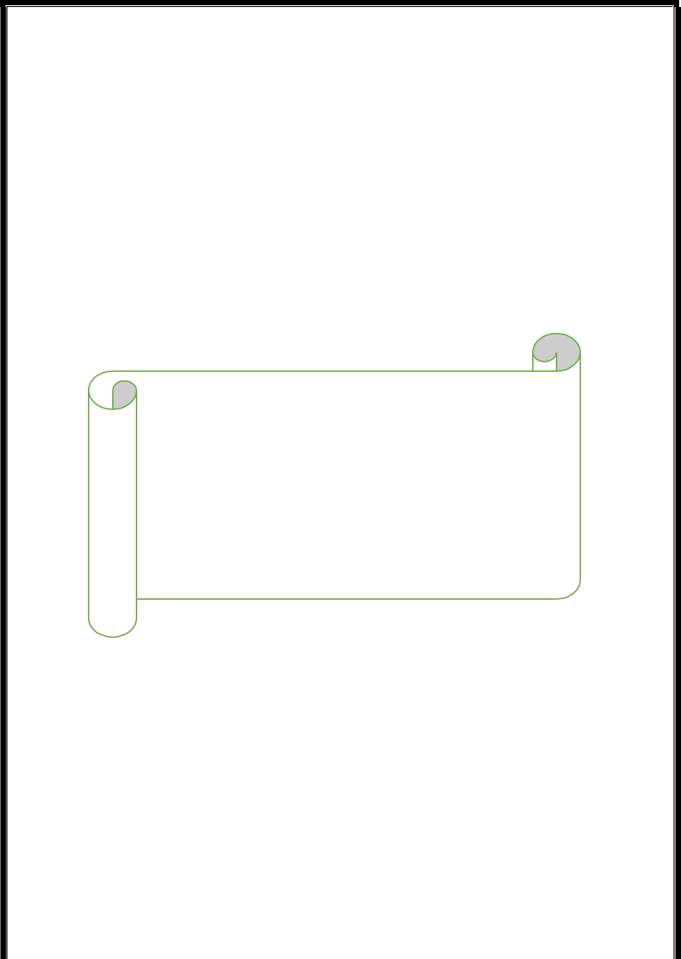
CONCLUSION & FUTURE
SCOPE
<number> | P a g e

Slide 31
CONCLUSION:
This paper review IOT based flood monitoring and control system, in some project they used water level sensor and GSM module but the problem is that it gives inaccurate values and sometimes due to network disturbance the villagers not receiving alert SMS at the time of flood. And there system is very costly. Our system based on SMS module as well as IOT (Internet of Things) that gives real time data and for getting accurate data of water level we used Ultrasonic sensor. As we are using GSM module and IOT device, it sends SMS to the villagers as well as it shows real time data of water level on a web page through IOT device. Our system is cheaper as compare to other system.
FUTURE SCOPE:
Many western European countries were recently subjected to severe flooding which resulted in huge economic losses and multiple deaths. Floods have become a frequent threat as a result of climate change, but with the development of artificial intelligence (AI), a much more advanced flood detection system has been developed based on deep computer algorithms.
The development of smart cameras and sensor technology helps detect the water levels and measure the probability of flooding even before the floods happen.
With much more research being carried out to improve flood monitoring systems, many governments are investing in much quicker methods of detection. Aside from real-time analysis, visualization will also help emergency authorities to showcase current conditions, allowing citizens to take action and prepare adequately.
<number> | P a g e

Slide 32
REFERENCES
<number> | P a g e

Slide 33
REFERENCES:
1. https://www.engineersgarage.com/electronic-components/16x2-lcd-module-datasheet
2. Real time car parking system using Arduino control- research paper by Maira Khalid 3.http://www.micropik.com/PDF/HCSR04.pdf
3 . Zamshed Iqbal Chowdhury, Haider Masudul Imtiaz, Moinul Muhammad Azam, Aktar Mst. Rumana Sumi, and Nafisa Shahera Nur, &quot;Design and Implementation of Pyroelectric Infrared Sensor Based
4. Security System Using Microcontroller,&quot; in Proceeding of the 2011 IEEE Students&#39; Technology
5. Symposium 14-16 January, 2011, lIT, Kharagpur, 2013.
<number> | P a g e

